Slide 1



Tattooing
Ainsley

Slide 2
Before we start…
Do any of you guys have a tattoo?
How was your experience?
Would you have more?........

Slide 3


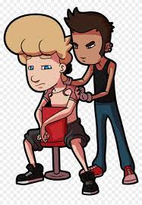
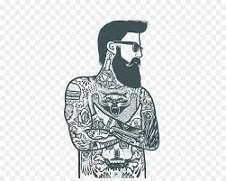

z
What is a tattoo?
A tattoo is a form of body modification made by inserting ink into the dermis layer of the skin. The dermis layer is only about 2mm in thickness, so when you're tattooing you have to be very precise. If not you run the risk of the tattoo looking scratchy and ‘falling out’, or go too deep and get a blow out. Its scary business.
Fun fact……it’s an automatic sure fire thing in finding you a lover……or prison……but you can always find your next lover in prison. So WIN WIN if you ask me.
They generally have a meaningful reasoning behind it….. well they used to. Now they’re more commonly just a ‘thing’ that people want as design on their body.
Tattoos date back to Ancient Egypt, that’s where hand poked tattooing was born. Many cultures and communities around the world use tattoos to indicate a number of different things from their tribe to entering into adulthood.

Slide 4

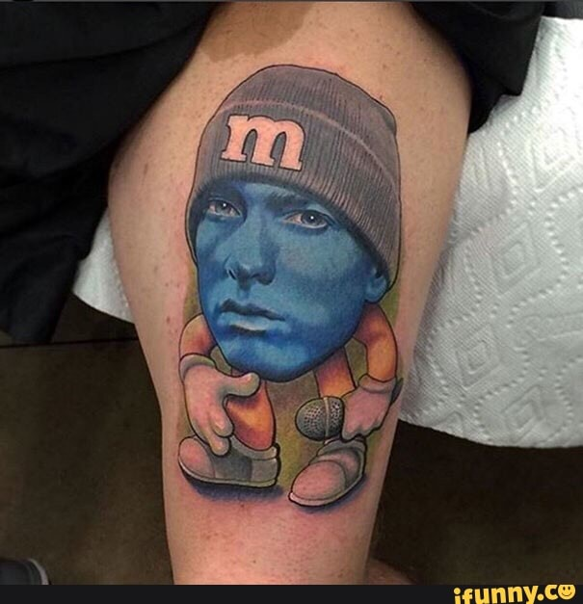
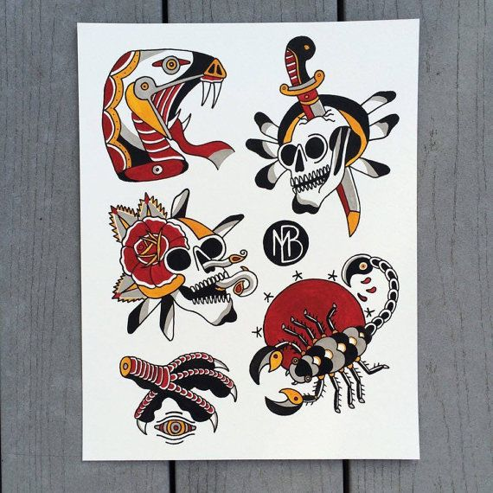
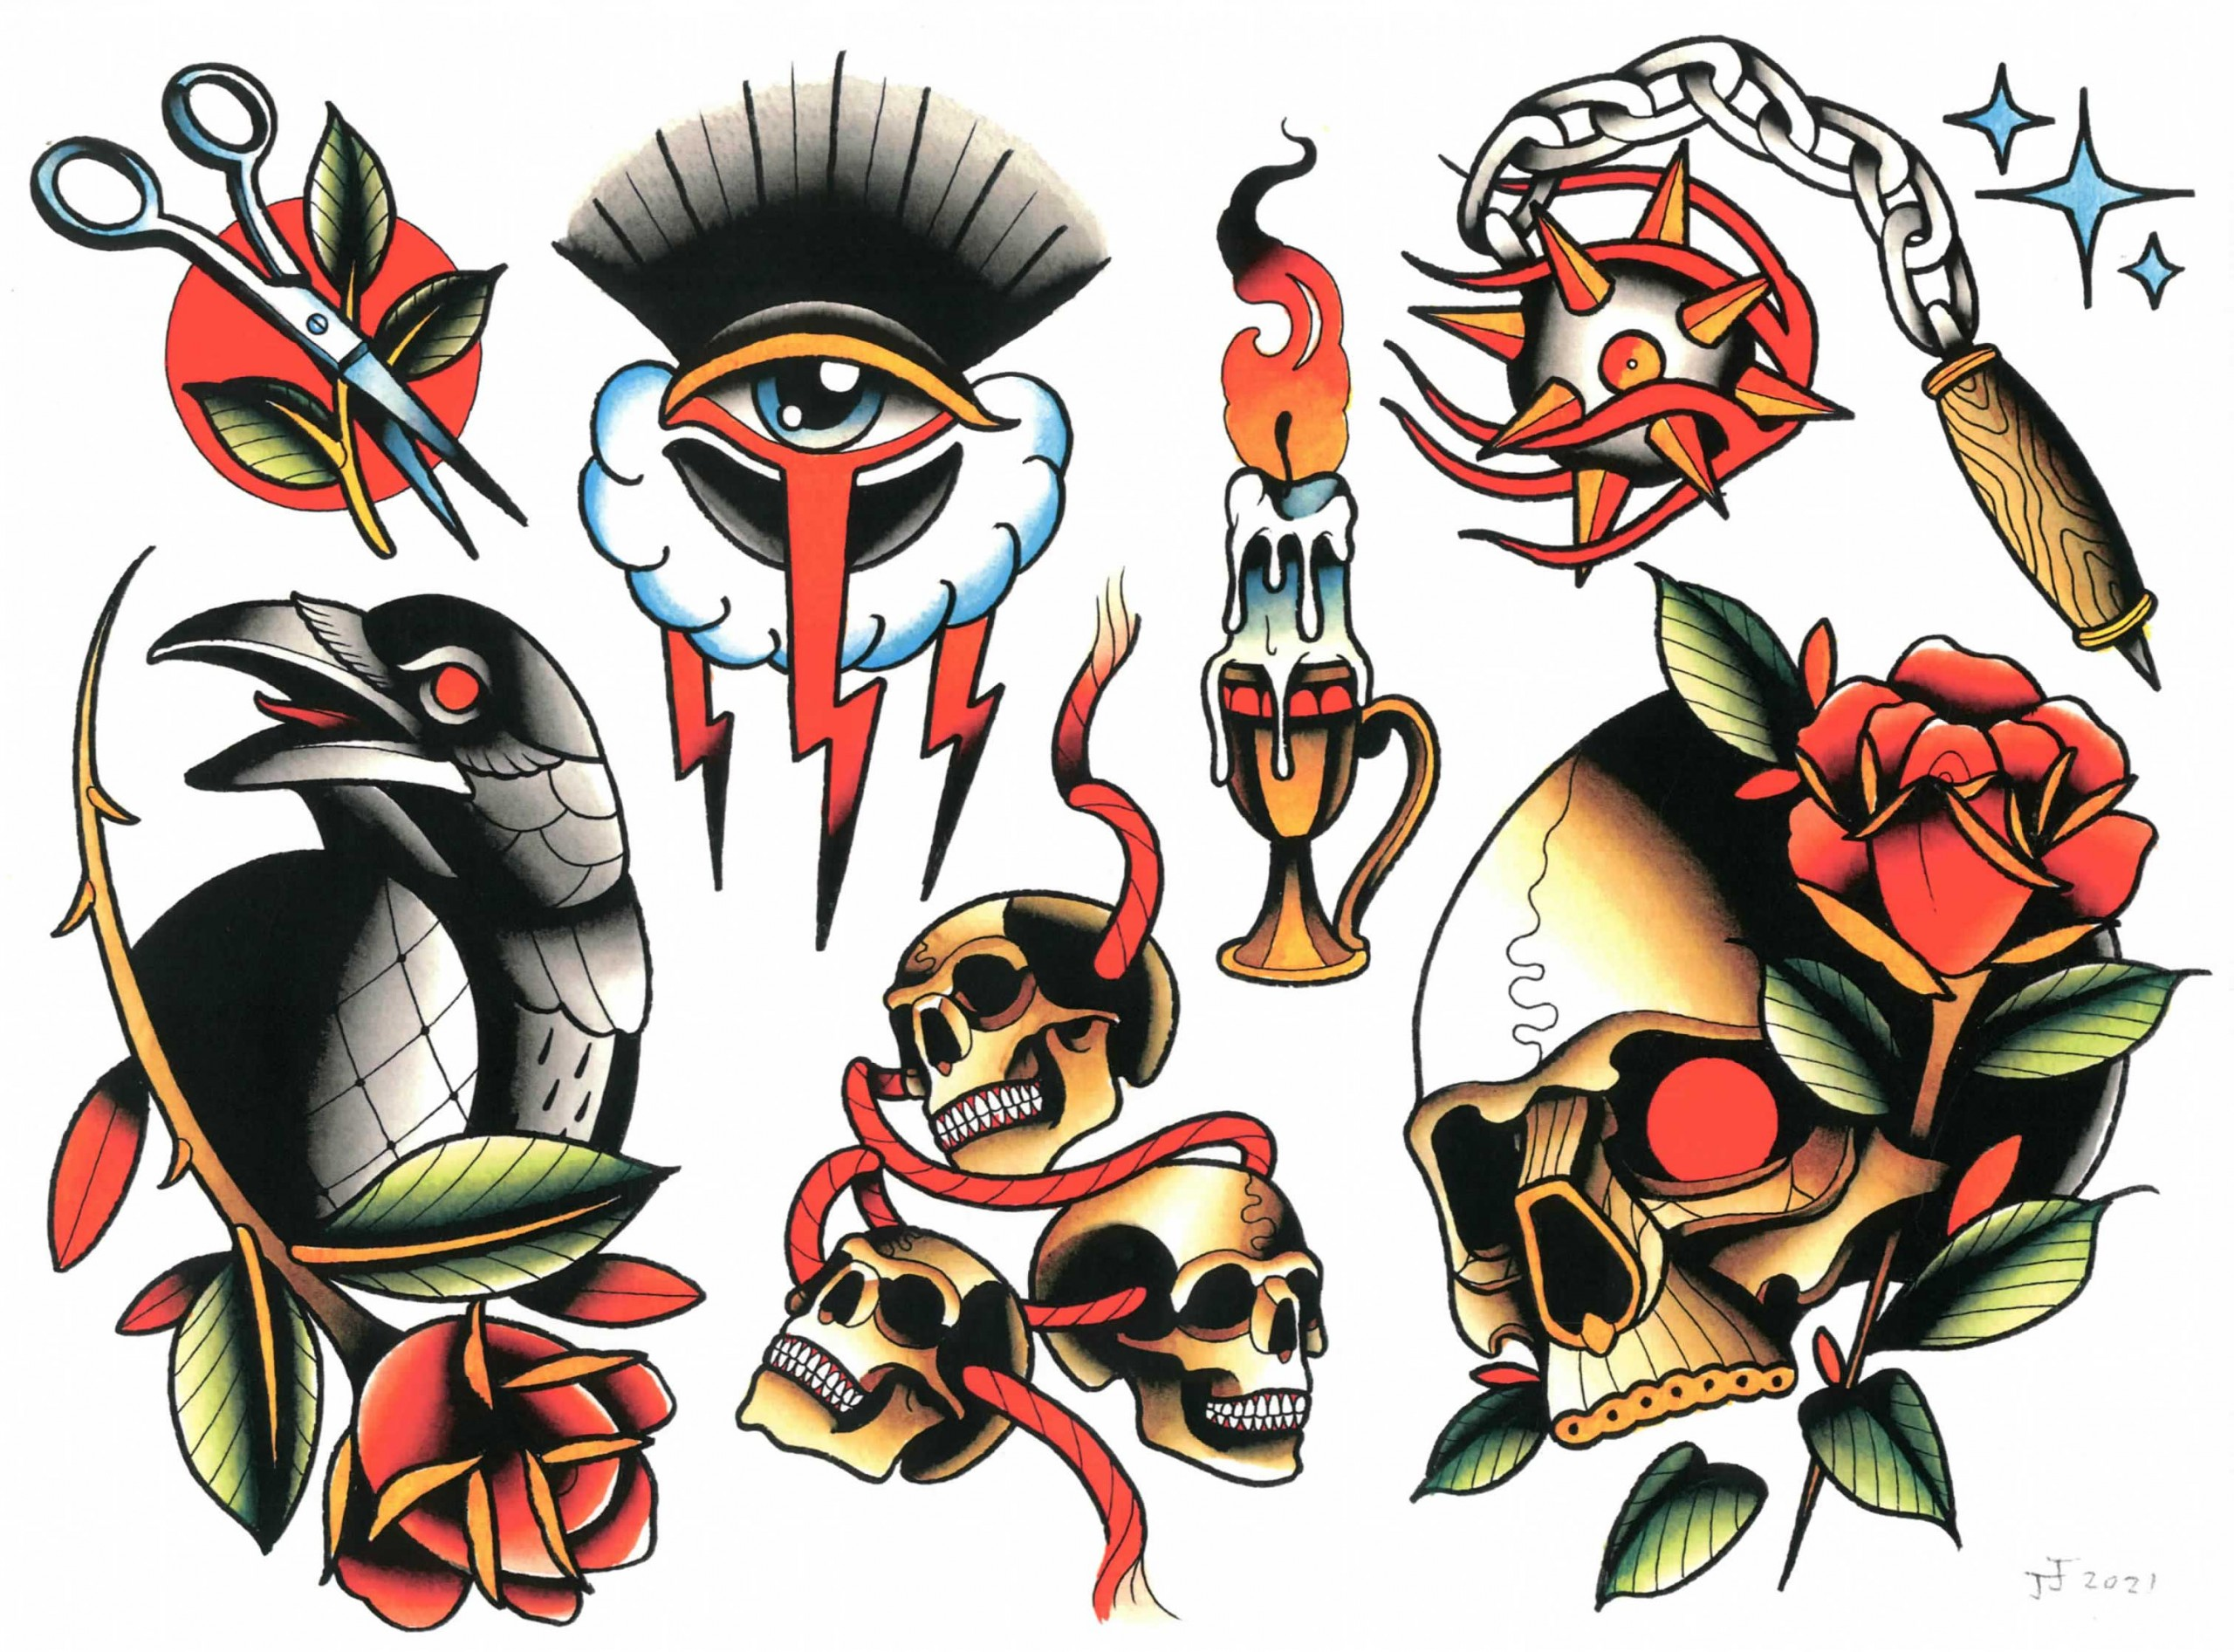
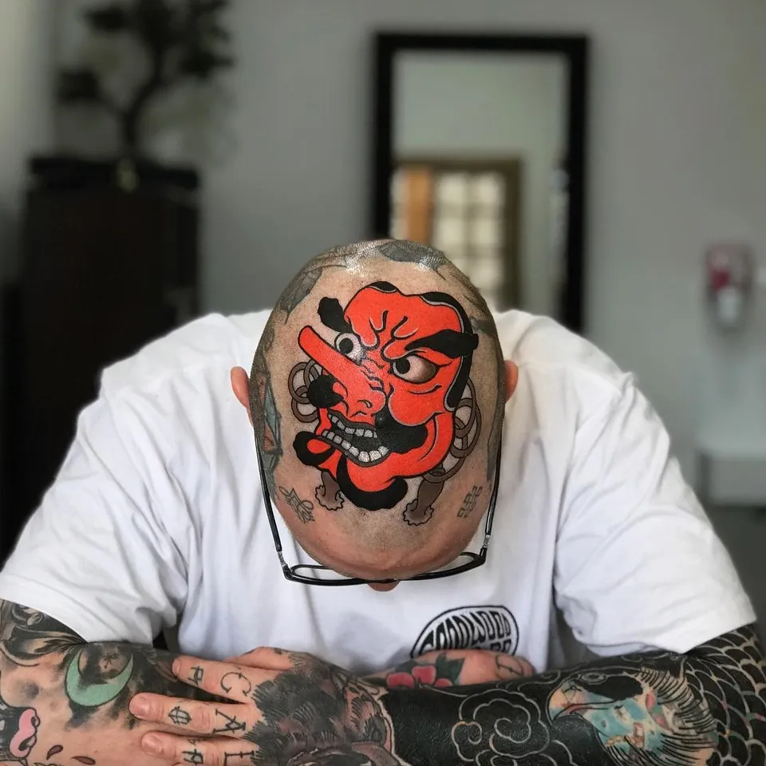
Different Styles Of Tattoos
z
Traditional/Neo-Traditional
Japanese
Photo realism
Dot work
Geometric (one of my favourite to do)
And more.......
Black and Grey
Old school /New School

Slide 5
z
I've been tattooing for about 7 or so years, I genuinely find it REALLY REALLY therapeutic, and super interesting. No 2 tattoos are the same, even when they're on the same person. the skin literally differs from place to place.

Slide 6
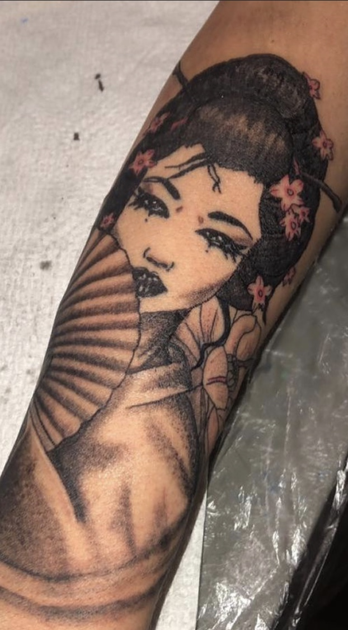
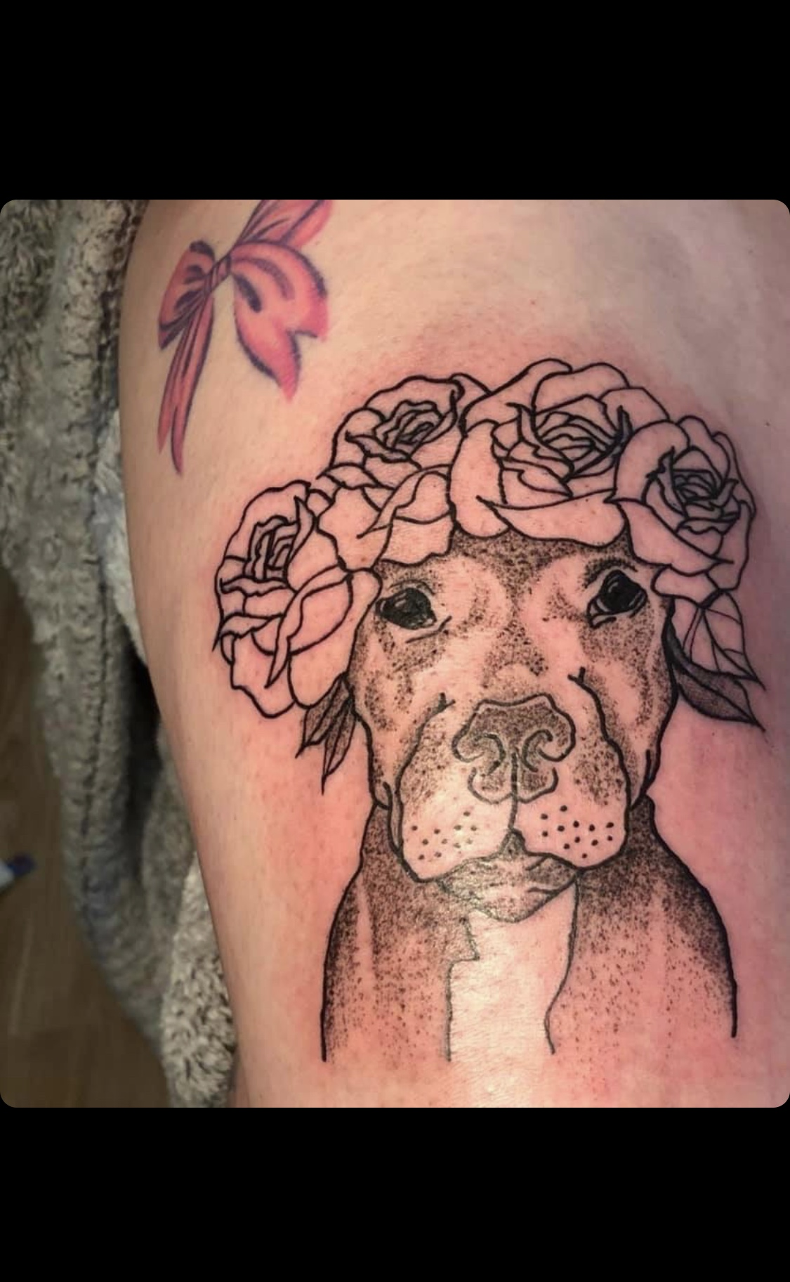
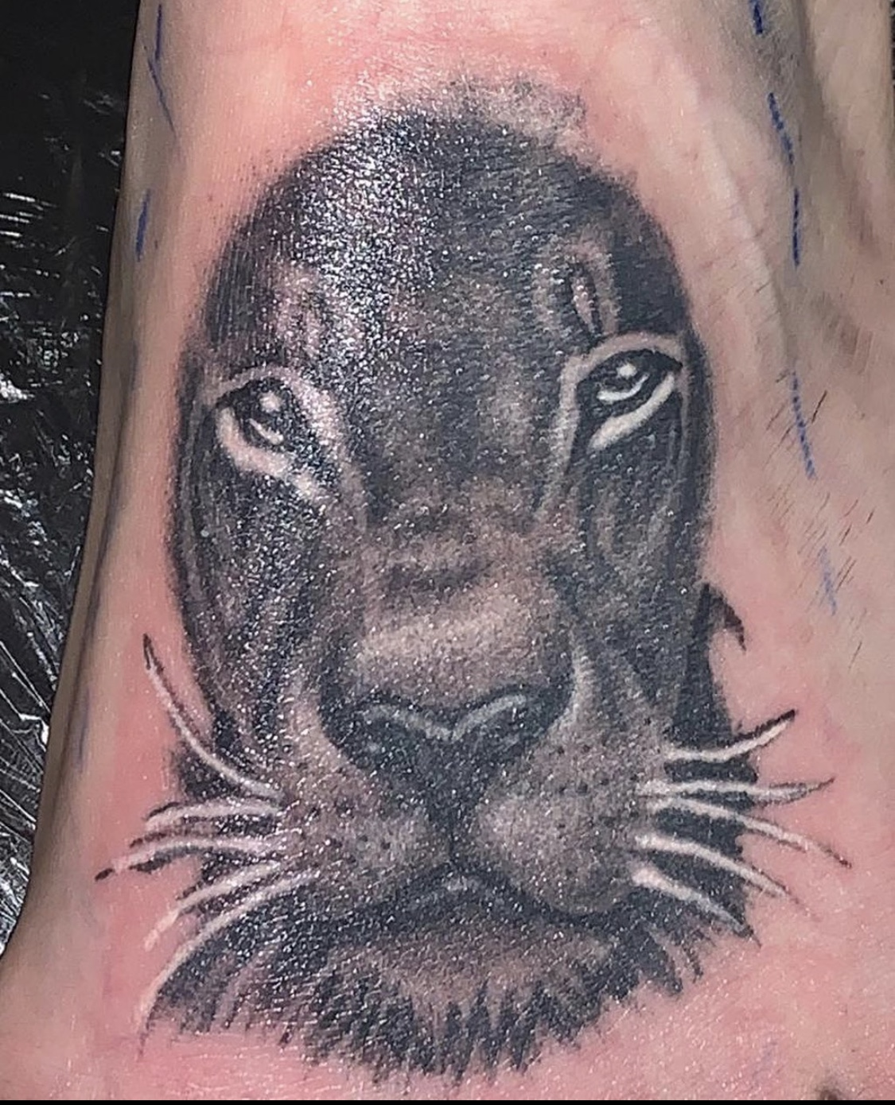
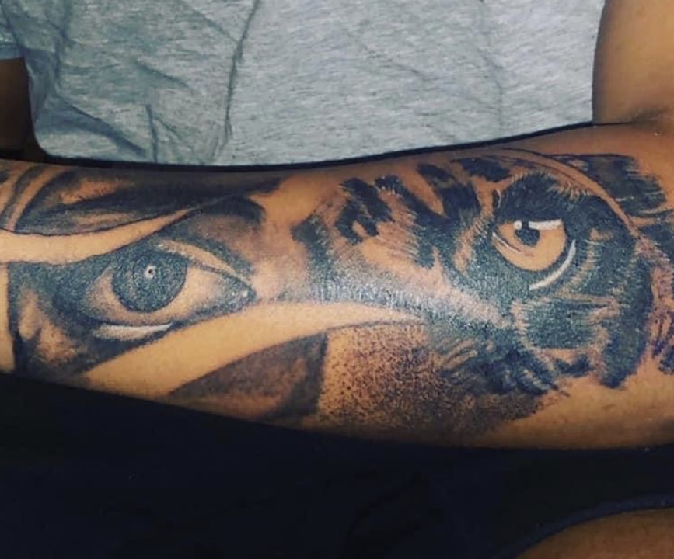
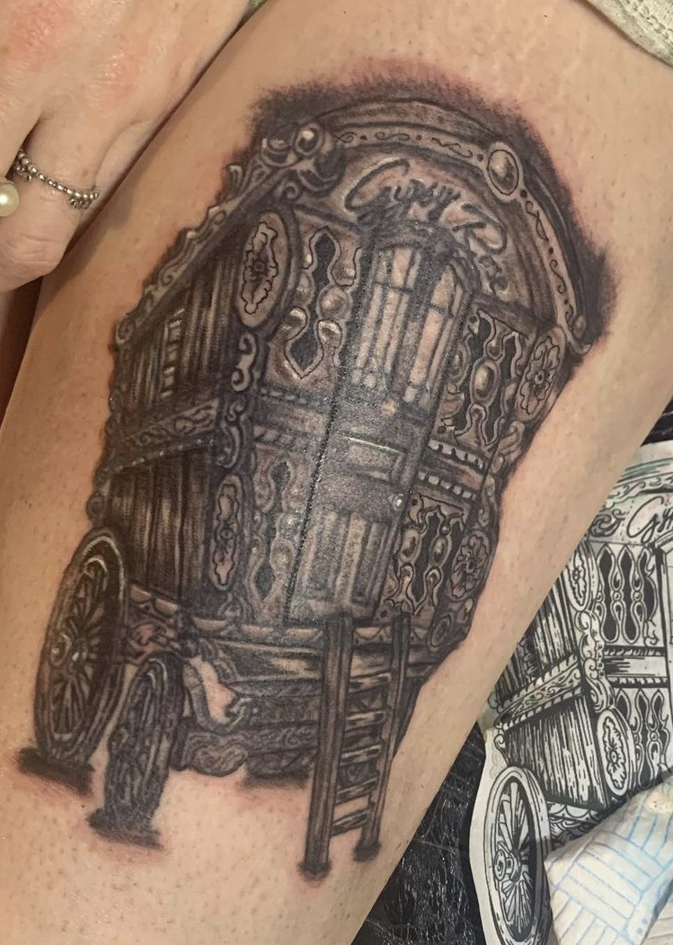

Slide 7
z
When I first got my kit, I thought I can finally be covered now…..little did I know all these years later I've barely added an extra 5.
Currently I'm on about 20 odd, not enough if you ask me but too much if you ask my mum. Although she has a habit of making me tattoo her, always when I'm done for the day. Seeing that its her I can't say no……but I do!
Its her birthday next month, chocolate bar to anyone that can guess what she's getting??

Slide 8
My next project is….
z

Slide 9
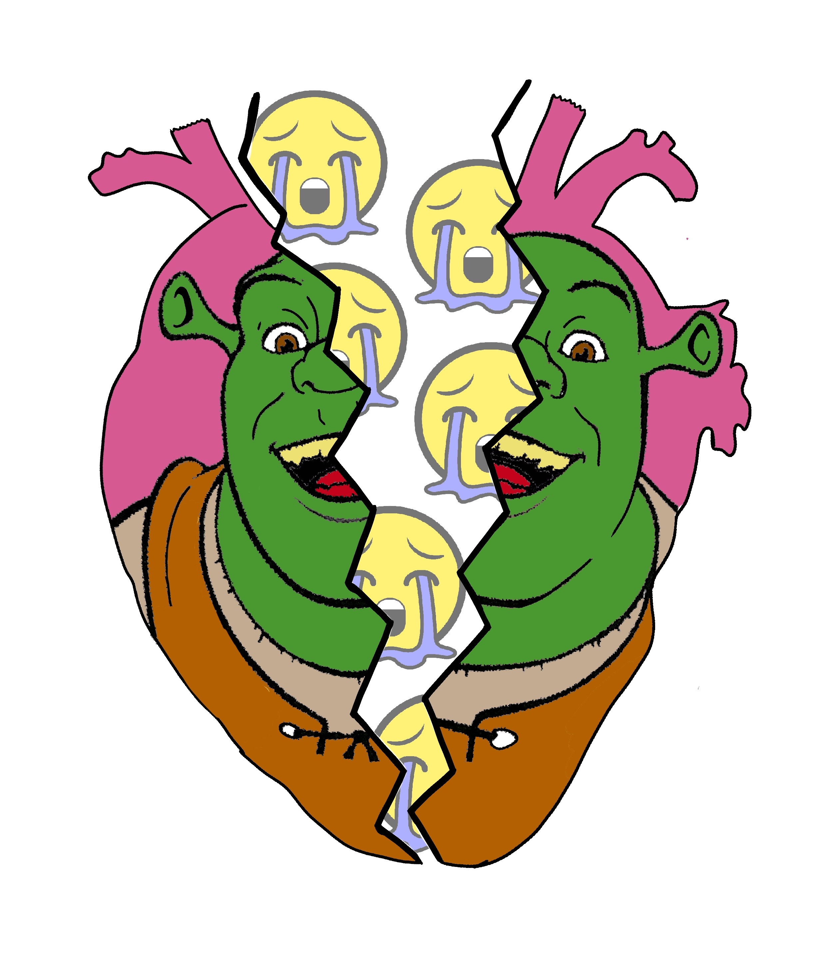

Slide 10
z
END!!!!

